Slide 1

Online Crime Report Management System
Project group 10:
Rajendrakumar ganji
AISHWARYA NAIDU KOTLA
PRANAY REDDY SINGIREDDY
VISHNU MONISH KANKANALA

Slide 2
GOAL OF THE PROJECT
The main goal of this web application is to provide crime related solutions which are easily accessible to everyone.
If a citizen want to file a crime of any non-emergency, He/she should visit a police station to file the complaint. To know the status of case He/she must visit respective police station regularly. This is a time taking process.
So we developed a webapplication which gives solution to this. By using our website citizens can complaint crime through online . They can also upload pictures and all the relevant information of the case.
Citizens can also check the status and updates of the complaint.

Slide 3
Approach
Citizens can register to our web application by providing all the details in the sign-up page. Where they need create a username and password.
Once the citizen logins into the website with his credentials he will be redirected to the home page of our application. There are multiple options to file a complaint.
By selecting the type of crime and location He/she files a complaint.
We have police records in the database. Based on place of occurrence of crime incident, our Portal will assign a police officer.
By clicking the status button citizens are asked to enter there case number so with that they can check the status of the case.
Once the case gets resolved then police officer will update the status of the case in the portal.

Slide 4
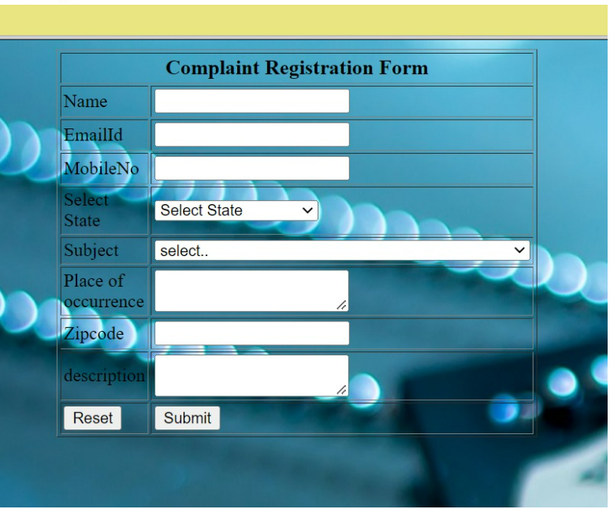
How to file a Complaint
The user can login with his credentials and click on register complaint. The below screen shows up and he can enter all his details.
Based on his zip code a police officer is assigned to his case.

Slide 5
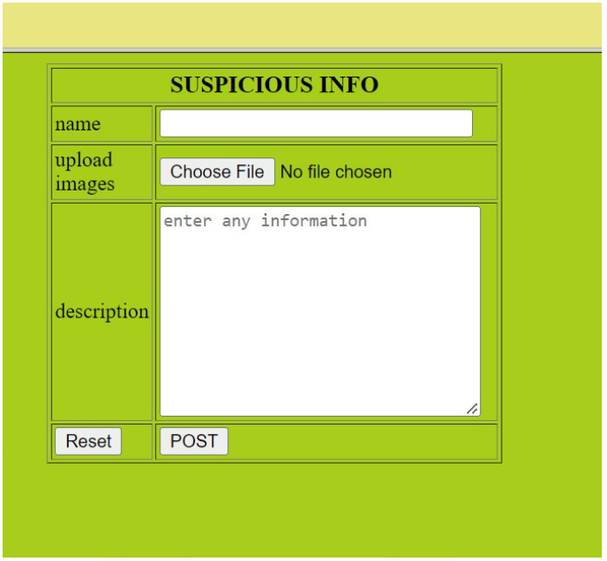
Adding Suspicious information
Along with filing the case the user can also add some suspicious information, this may help the officer with further information on the case.

Slide 6
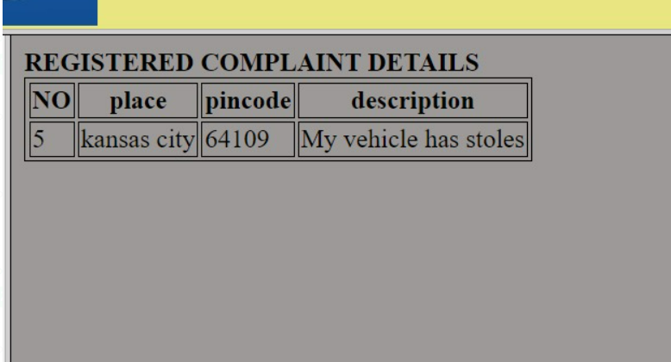
How is the Case Viewed
As the case is assigned to an officer, the officer can login with his credentials and view the details of the cases assigned to him.
If the officer wants more information about the case, then he can contact the citizen
Once he has any update, he can write the comments and change the status from pending to solved.

Slide 7
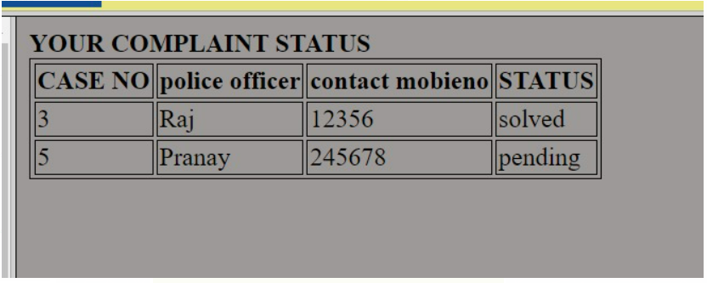
Checking the Status of the Case
The user can login with his Name and mobile number to check the status of the case.
Citizen can check the status of the case any time and he can also reach to the officer if needed.

Slide 8
Technology Stack
Front End Development : HTML, CSS, JAVASCRIPT
Back End Development : PHP
SERVER : XAMP SERVER
DATABASE : MYSQL

Slide 9
Disadvantages of Existing System
Existing system process is time consuming.
Victim may be afraid of visiting the police station though he has a problem.
Information Management is not effective in the existing system.
No direct role for the higher officials

Slide 10
Advantages of Proposed system
Ensure data Accuracy.
Proper control of the higher officials.
Minimize manual data entry.
Minimum time needed for the various processing.
Greater efficiency.
Better service.
User friendliness and interactive.
Minimum time required.

Slide 11
THANK YOU

